Slide 1
Project name : Review Me
Review and List your favorite films

Slide 2
Team members
Awab Khaled Abd Allah
Raed Reda Yassin
Ayman Osama Sayed
Zeyad Ahmed Ali
Zeyad Mohamed Hashem

Slide 3
Purpose of our project
Our site targets movie lovers (cinephiles) by offering you to :
Keep track of films you have watched
Show your opinion in films by listing, rating and reviewing films
Edit your profile with an easy-to-use design

Slide 4
Product Functions
Register and login
Search films
Viewing film's information (cast,trailer,poster,...etc)
Have a favorite list of films
Rate films
Write your opinion and review about the movie
Modify and remove your account

Slide 5
PAGES

Slide 6
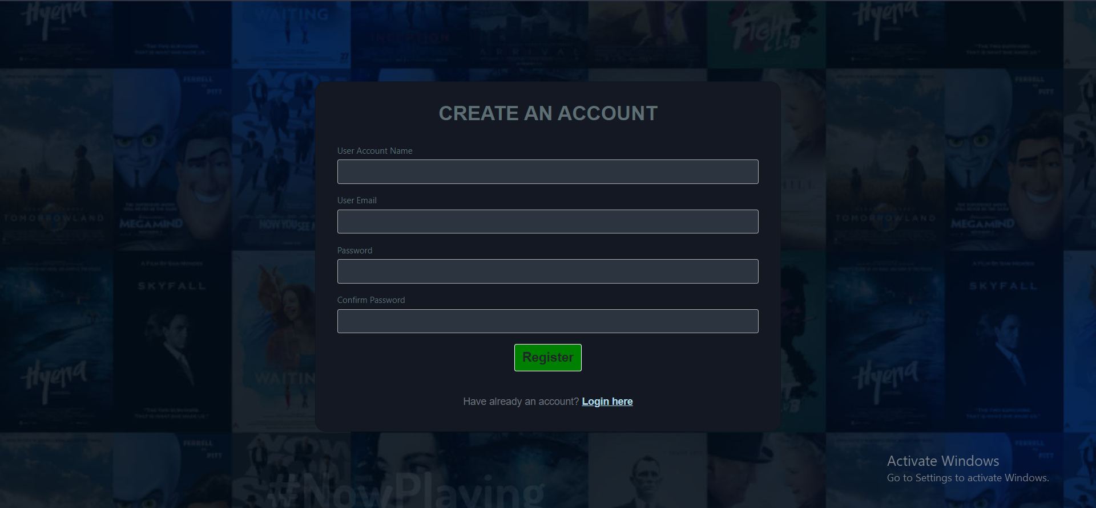
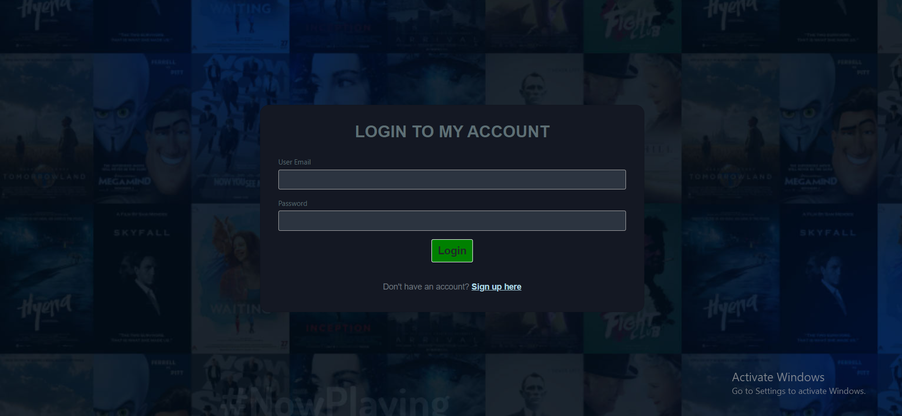
Login and Register

Slide 7
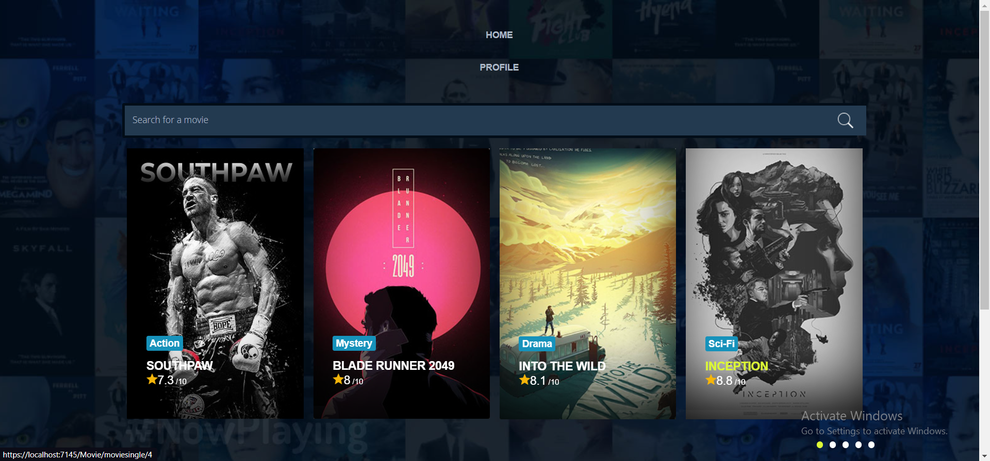
Home Page

Slide 8
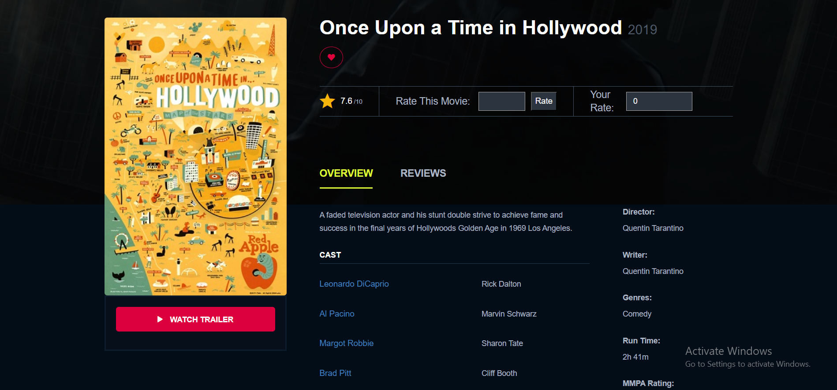
Film

Slide 9
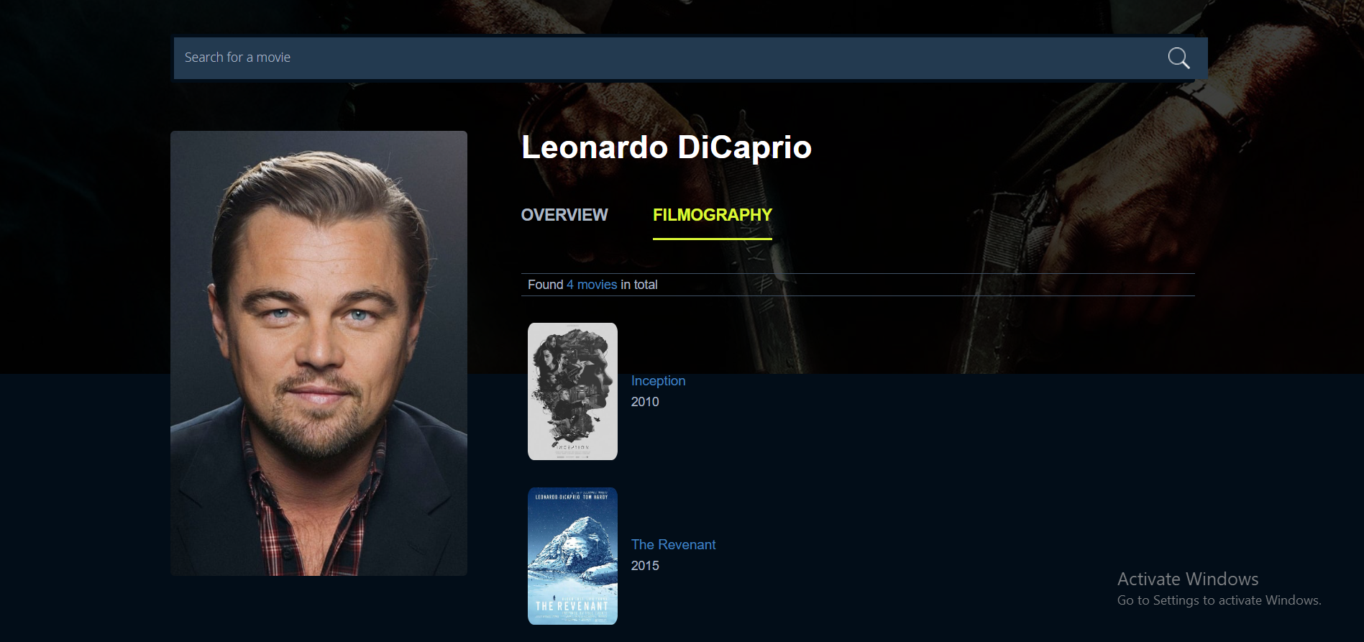
Actor Page

Slide 10
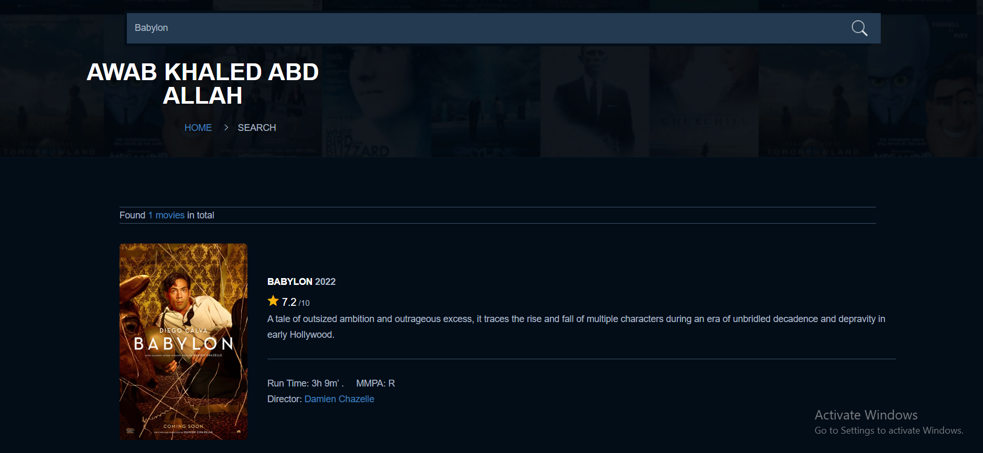
Search page

Slide 11
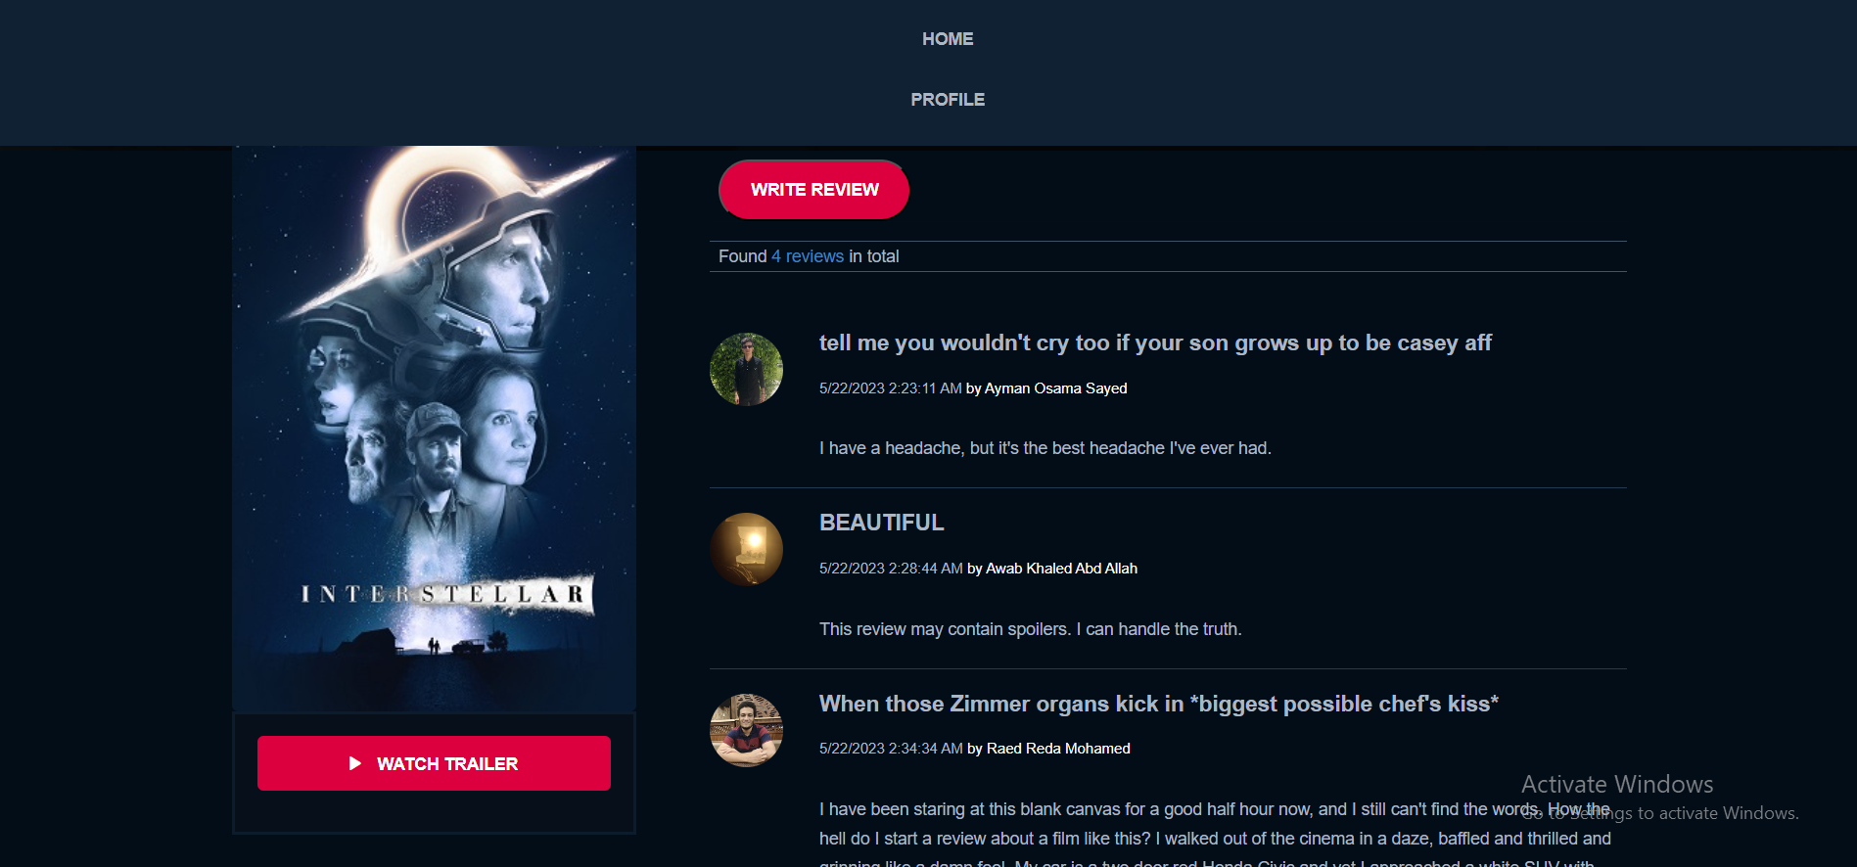
Film Reviews

Slide 12
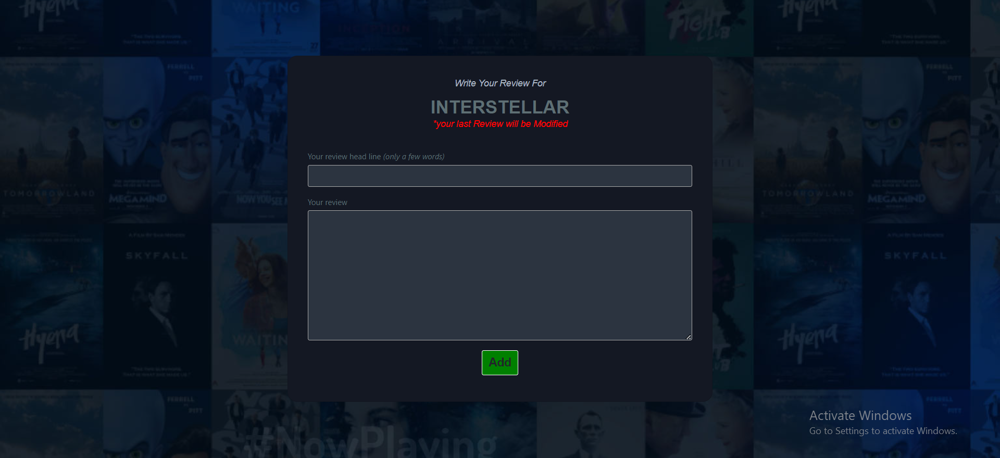
Write your Review

Slide 13
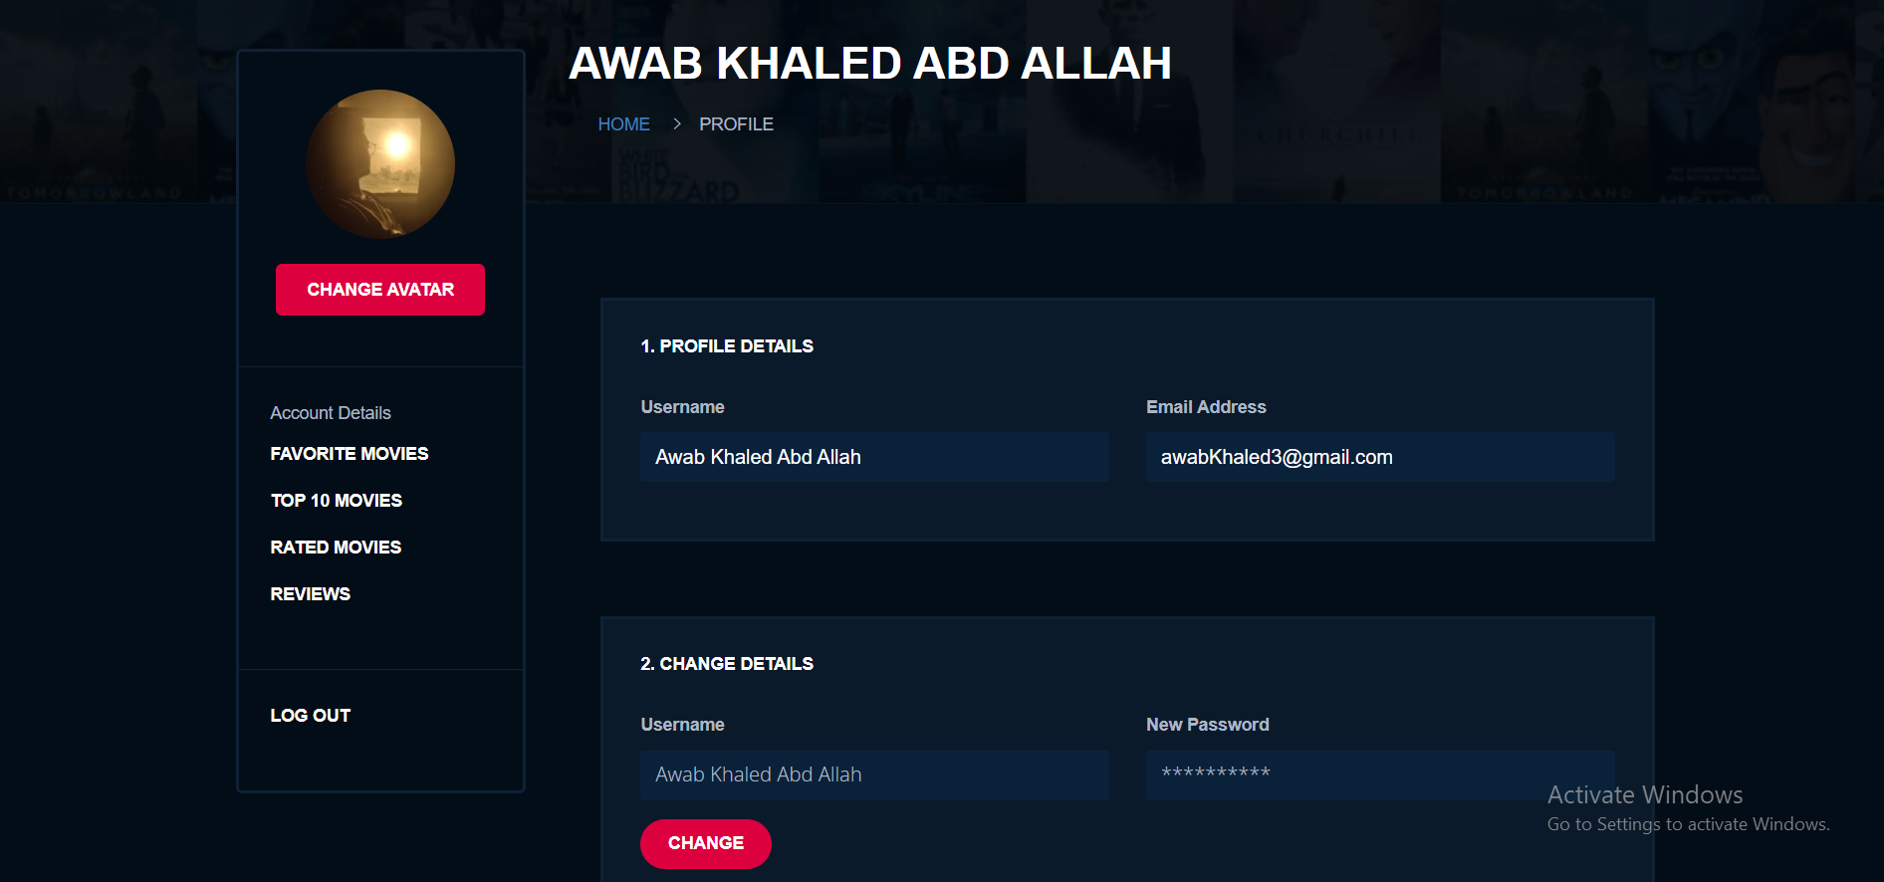
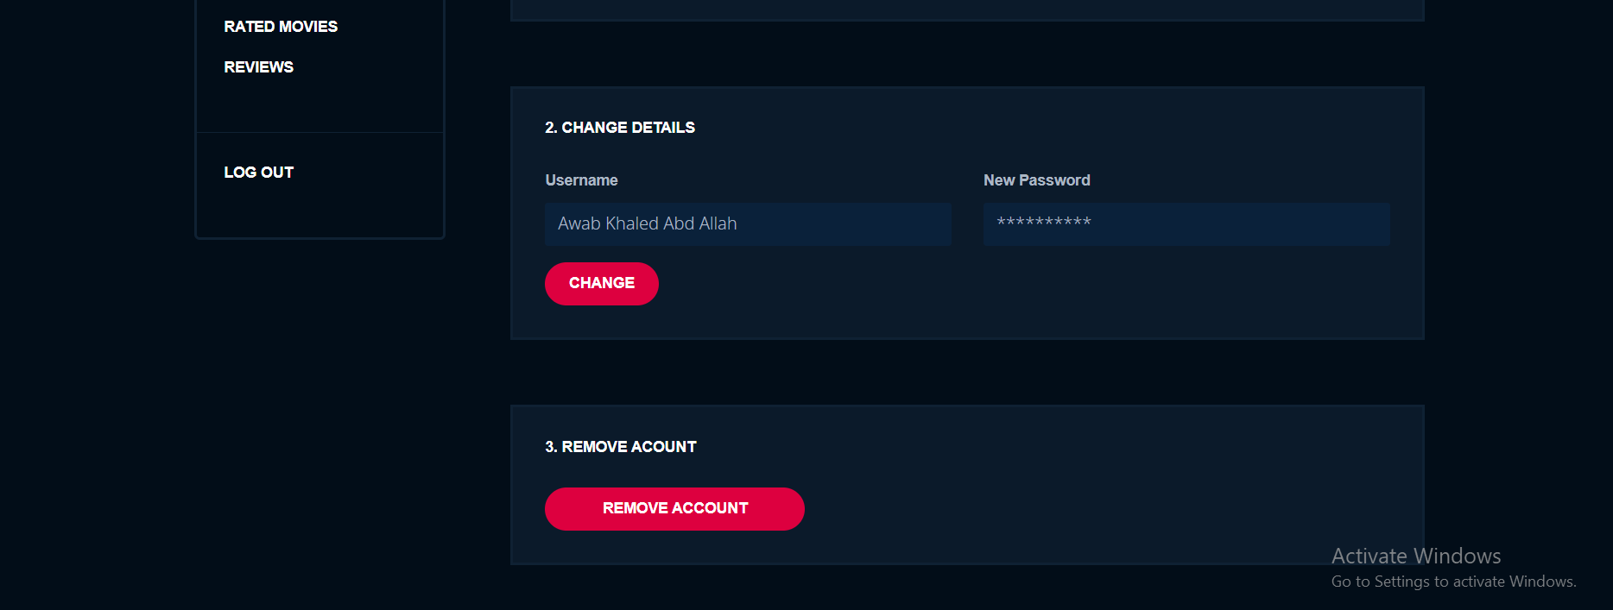
Profile Page

Slide 14
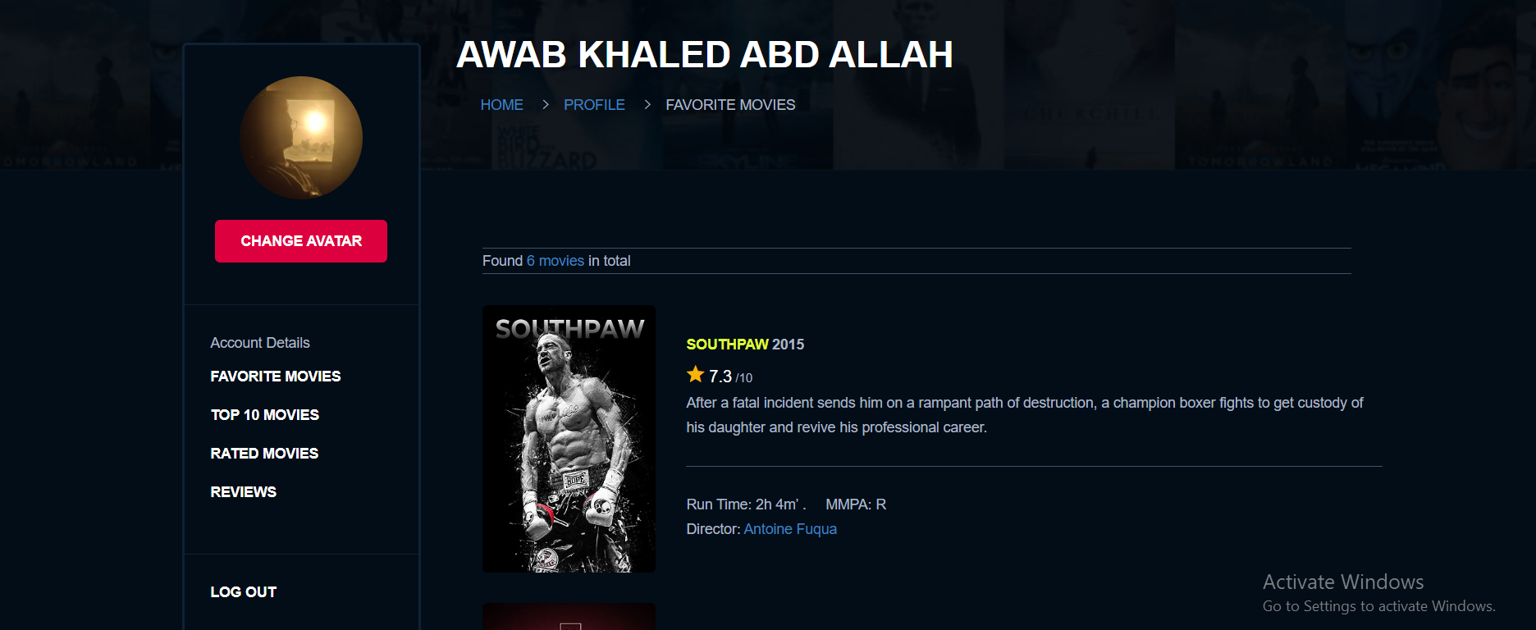
Favorite Movies page

Slide 15
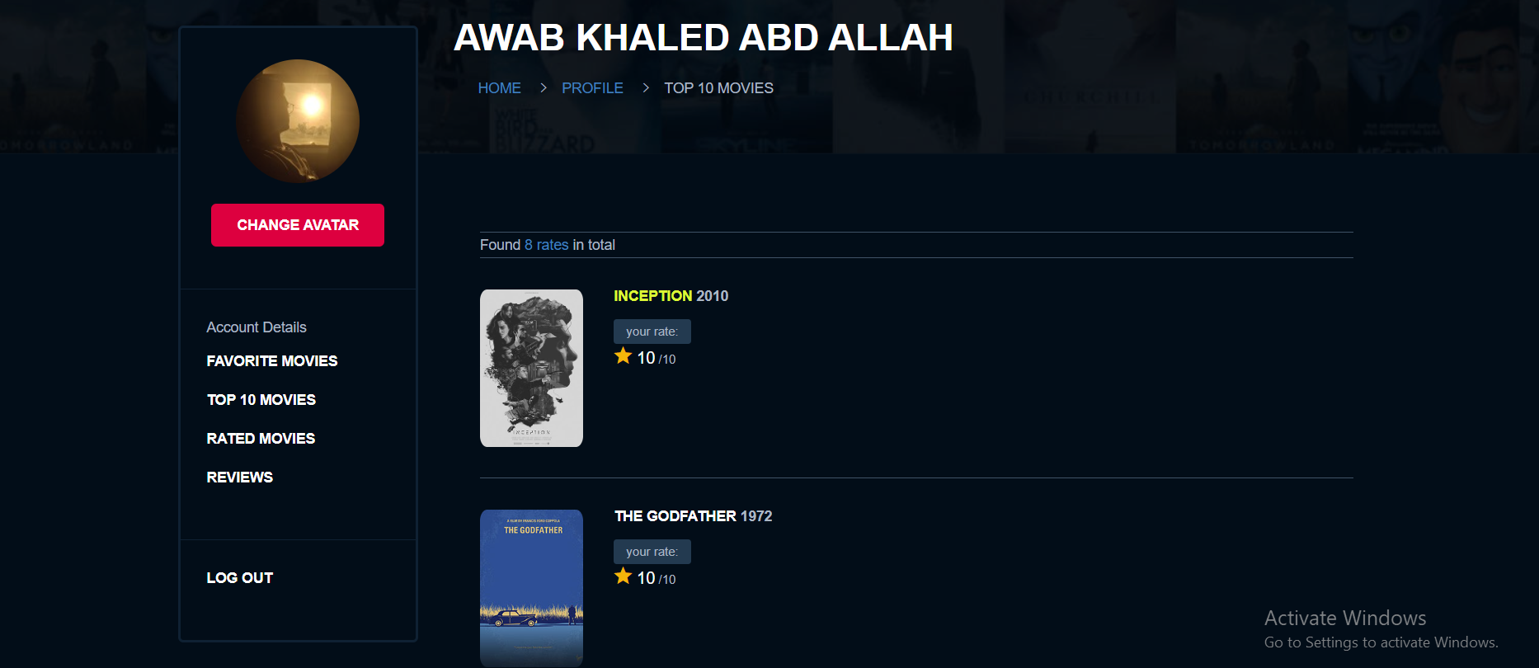
Top 10 Movie page

Slide 16
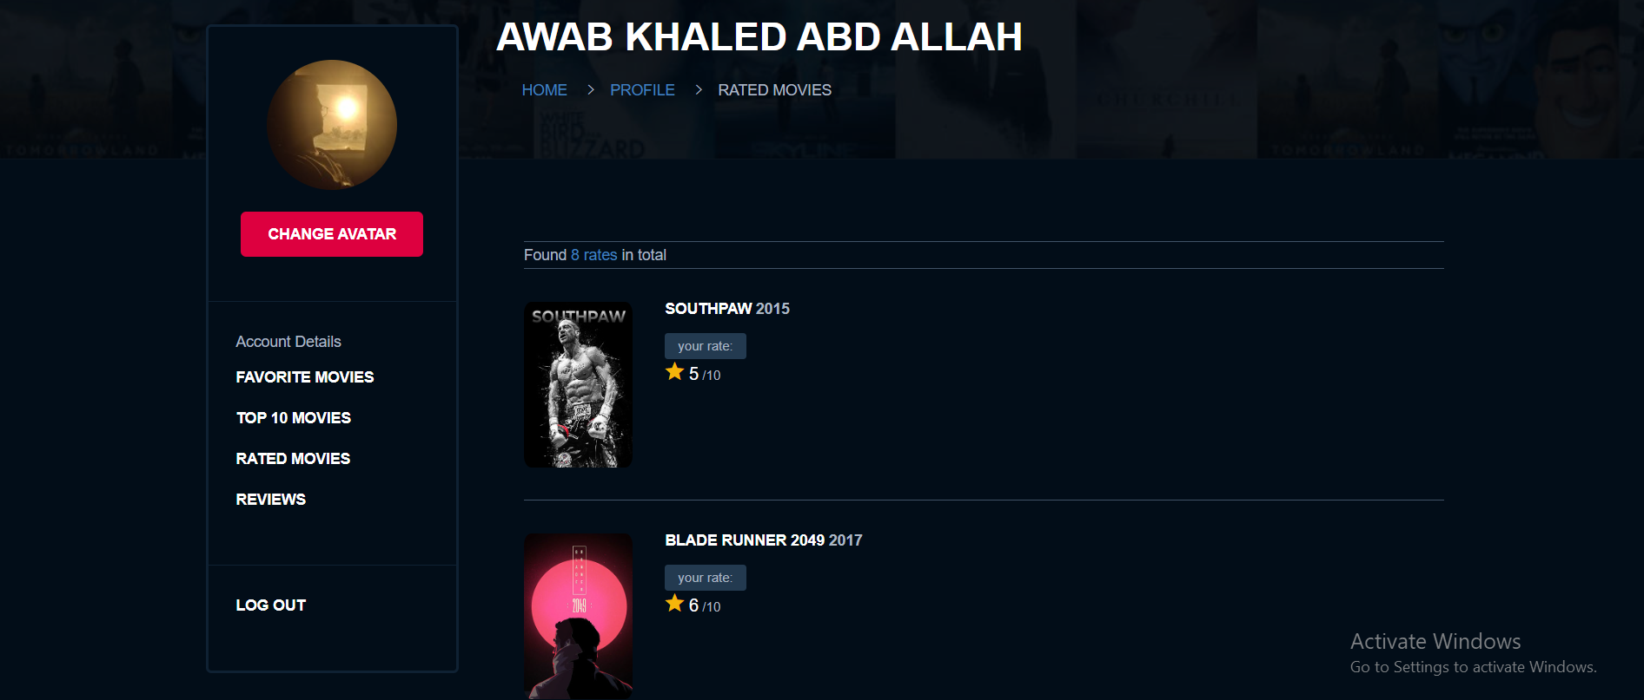
Rated Movies

